Slide 1

School of Computing Science and Engineering
Course Code: BCS0IT1003 Course Name: Programming for Problem Solving-C
Unit – 2
Control Statements - 1
Program Name: B.Tech

Slide 2
Control statements in C
Control statements:
Decisions(if-else),
Loops (while, for, do while)
break, continue
case control structure
go to
exit statement

Slide 3
Control statements in C
C categorizes statements into these groups:
• Selection statements - if and switch
• Iteration statement - for, while and do-while.
• Jump - break, continue, return, goto and exit
• Label - case and default

Slide 4
Selection or Decision Making statements
C supports two selection statements: if and switch.
In addition, the Ternary (?) operator is an alternative to if in certain circumstances.
‘ if ‘statement are further classified into :
if
if – else
nested if
else if ladder
Ternary operator (alternate of if-else)

Slide 5
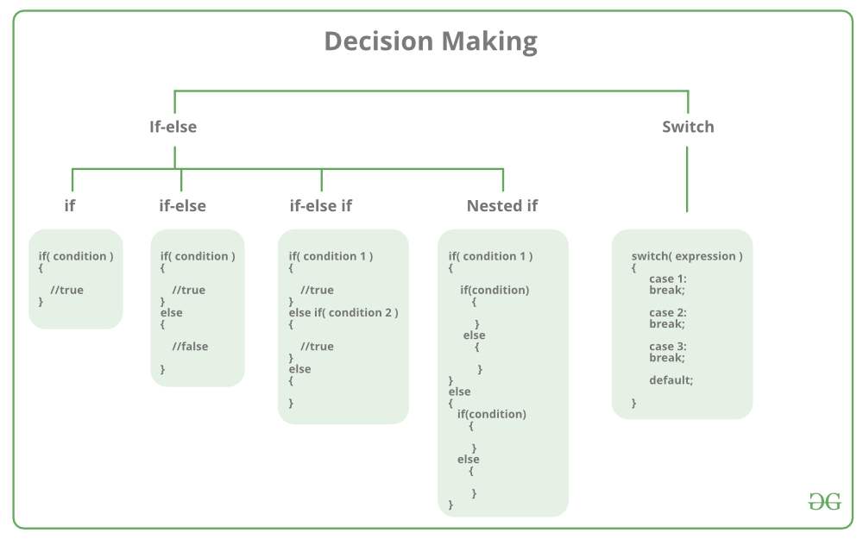
Selection or Decision Making statements

Slide 6
Selection or Decision Making statements
if statement
Example program for “if”
Write a C program to find the given Number is even?
#include <stdio.h>
int main(void)
{
int a;
printf(“Enter a Number : ”);
scanf(“%d”,&a);
if(a%2==0)
printf(“Given Number is Even”);
Else
Printf(“number is odd”);
return 0;
}
OUTPUT
Enter a Number : 6
Given Number is Even

Slide 7
Selection or Control statements
if statement
/* Magic number program using if */
#include <stdio.h>
#include <stdlib.h>
int main (void)
{
int magic; /* magic number */
int guess; /* user's guess */
magic = rand(); /* generate the magic number */
printf("Guess the magic number: ");
scanf("%d", &guess);
if(guess == magic)
printf("** Right **");
return 0;
}
There is no else clause defined in the above example.

Slide 8
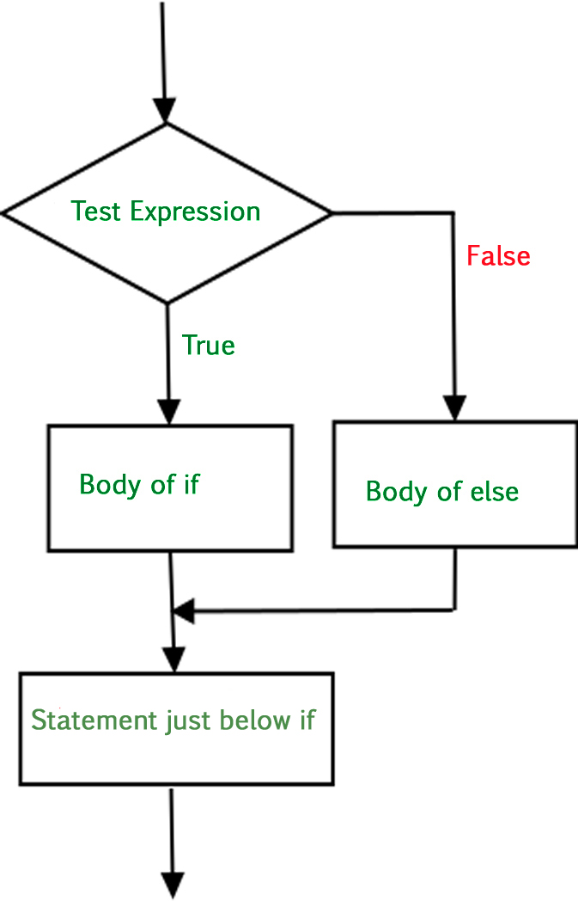
Selection or Control statements
if-else statement
The general form of the if statement is
if (expression)
statement;
else
statement;
If expression evaluates to true (anything other than 0), the statement or block that forms the target of if is executed; otherwise, the statement or block that is the target of else will be executed, if it exists.
where a statement may consist of a single statement, a block of statements, or nothing (in the case of empty statements).
The else clause is optional.

Slide 9
Selection or Control statements
if-else statement
Example program for “if-else”
Write a C program to find the greatest among two numbers ?
#include <stdio.h>
int main(void)
{
int a,b;
printf(“Enter Number 1 : ”);
scanf(“%d”,&a);
printf(“Enter Number 2 : ”);
scanf(“%d”,&b);
if(a>b)
printf(“Number 1 is greater”);
else
printf(“Number 2 is greater”);
return 0;
}
OUTPUT
Enter Number 1 : 20
Enter Number 2 : 10
Number 1 is greater
OUTPUT
Enter Number 1 : 10
Enter Number 2 : 20
Number 2 is greater

Slide 10
Selection or Control statements
if-else statement
/* Magic number program using if-else */
#include <stdio.h>
#include <stdlib.h>
int main (void)
{
int magic; /* magic number */
int guess; /* user's guess */
magic = rand(); /* generate the magic number */
printf("Guess the magic number: ");
scanf("%d", &guess);
if(guess == magic)
printf("** Right **");
else
printf(“** Wrong **”)
return 0;
}
Here both true part and false part of if were defined in the above example.

Slide 11
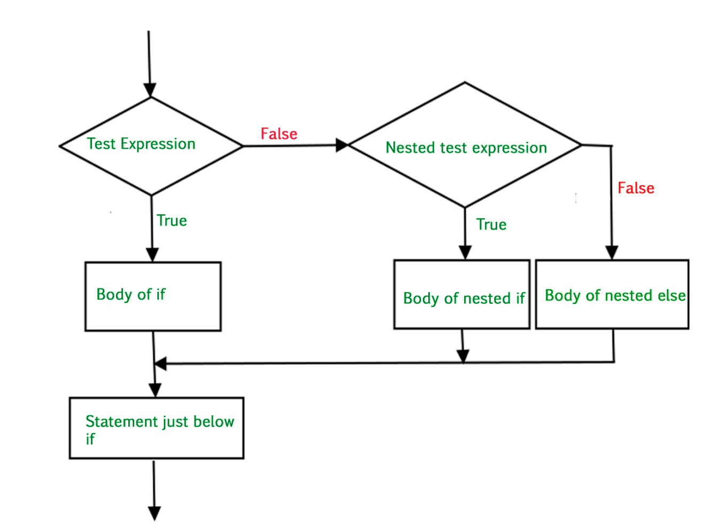
Selection or Control statements
Nested if statement
A nested if is an if that is the target of another if or else.
In a nested if, an else statement always refers to the nearest if statement that is within the same block as the else and that is not already associated with an else.

Slide 12
Selection or Control statements
Nested if statement
Example program for “nested if”
Write a C program to find the grade of students ?
#include <stdio.h>
int main()
{
int i;
printf("Enter the mark : ");
scanf("%d",&i);
if (i >0)
{
if (i >=60)
printf(“Secured I Class\n");
else
if (i >=45 && i<60)
printf(“Secure II Class \n");
else
printf("Fail mark");
}
return 0;
}
OUTPUT
Enter the mark : 75
Secured I Class
Enter the mark : 55
Secured II Class
Enter the mark : 44
Fail mark

Slide 13
Selection or Control statements
Nested if statement
/* Magic number program using nested if */
#include <stdio.h>
#include <stdlib.h>
int main(void)
{
int magic; /* magic number */
int guess; /* user's guess */
magic = rand(); /* get a random number */
printf("Guess the magic number: ");
scanf("%d", &guess);
if (guess == magic)
{
printf ("** Right **");
printf(" %d is the magic number\n", magic);
}
else
{
printf("Wrong, ");
if(guess > magic) printf("too high\n"); /* nested if */
else
printf("too low\n");
}
return 0;
}

Slide 14
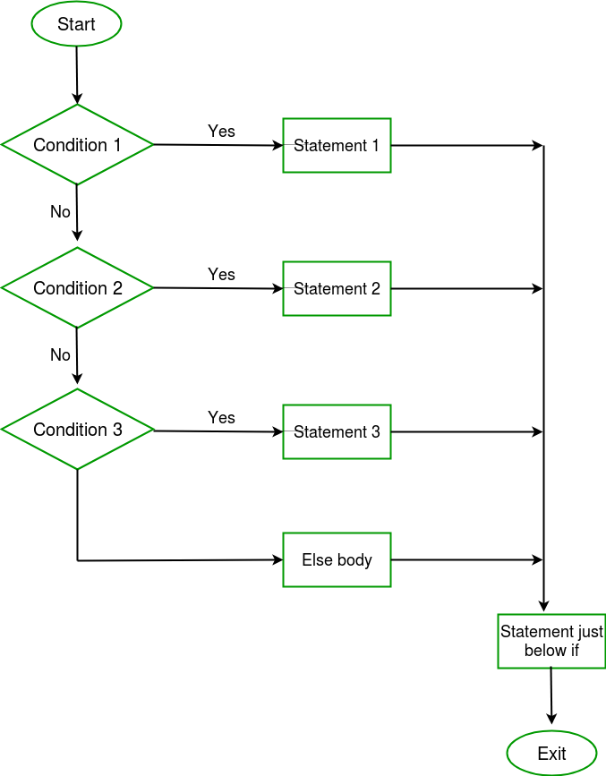
Selection or Control statements
The if-else-if Ladder
if-else-if ladder, sometimes called the if-else-if staircase because of its appearance. Its general form is
if (expression) statement;
else
if (expression) statement;
else
if (expression) statement;
.
.
.
else statement;

Slide 15
Selection or Control statements
The if-else-if Ladder
The conditions are evaluated from the top downward. As soon as a true condition is found, the statement associated with it is executed and the rest of the ladder is bypassed.
If none of the conditions are true, the final else is executed. That is, if all other conditional tests fail, the last else statement is performed.
If the final else is not present, no action takes place if all other conditions are false.

Slide 16
Selection or Control statements
The if-else-if Ladder
Example program for “if else ladder”
#include<stdio.h>
int main()
{
int i;
printf("Enter a Number to check : ");
scanf("%d",&i);
if (i == 0)
printf("Number is 0");
else if (i>0 && i%2 == 0)
printf("Number is Even");
else if (i>0 && i%2 == 1)
printf("Number is Odd");
else
printf("Number is less than 0");
return 0;
}
OUTPUT
Enter a Number to check : 100
Number is Even
Enter a Number to check : 151
Number is Odd
Enter a Number to check : 0
Number is 0
Enter a Number to check : -30
Number is less than 0

Slide 17
Selection or Control statements
The if-else-if Ladder
/* Magic number program using if-else-if ladder */
#include <stdio.h>
#include <stdlib.h>
int main(void)
{
int magic; /* magic number */
int guess; /* user's guess */
magic = rand(); /* generate the magic number */
printf("Guess the magic number: ");
scanf(''%d", &guess);
if(guess == magic)
{
printf("** Right ** ");
printf("%d is the magic number", magic);
}
else if(guess > magic)
printf("Wrong, too high");
else printf("Wrong, too low");
return 0;
}

Slide 18
Selection or Control statements
Ternary statement
Similar to the if-else statement as it does follow the same algorithm as of if-else statement but the conditional operator takes less space and helps to write the if-else statements in the shortest way possible.
Syntax:
variable = Expression1 ? Expression2 : Expression3
Which is equivalent to the code
if(Expression1)
{
variable = Expression2;
}
else
{
variable = Expression3;
}

Slide 19
Selection or Control statements
Ternary statement
#include <stdio.h>
int main()
{
int n1 = 5, n2 = 10, max;
max = (n1 > n2) ? n1 : n2;
printf("Largest number between %d and %d is %d", n1, n2, max);
return 0;
}
Output:
Largest number between 5 and 10 is 10

Slide 20
Thank You

